Slide 1
2023 Design Concepts: Cornish Democracy and Other Institute Publications.
Richard Skerratt - Graphic Designer - BA (Hons), MA
This presentation is in the black and white, Effra typography style of the final design.

Slide 2
What are we trying
to accomplish?
Attract a new audience, retain existing.
Consider contemporary design trends.
Design that does not ‘date’ quickly.
Re-usable design, use multiple times, different publications.
Catches people’s attention.

Slide 3
What are we
trying to avoid?
Tired design tropes.
Politically-loaded imagery.
Patriotic or flag-waving crowds.
A focus on the past.
Appealing to marginal interests.

Slide 4
Iconography Discussion
St Piran’s Flag – Overused.
Cornish Tartan – Stereotypical? Scottish?
Cornish Coat of Arms – Administrative?
Cornish Pasty – Risk of Cliché.
Surfing – Risk of Cliché.
Beaches – Risk of Cliché.
Cornish Chough – Association not sufficiently well understood?
Bezants – Association understood, not overused, not overtly political or cliched?

Slide 5
The Bezants have a distinct and distinctive iconography
They allows for interpretation over content and intent
But are also clearly recognisable as ‘Cornish’

Slide 6
Typography
Good fonts and bad fonts do not exist - only good and bad suitability for the project in hand. For a modern and simple look, a Serif font would look out of place - it would be in contrast to the minimal look of the cover. I propose an easy to read San Serif font like Effra, or similar to match the cover’s feel - keeping all design language consistent.

Slide 7
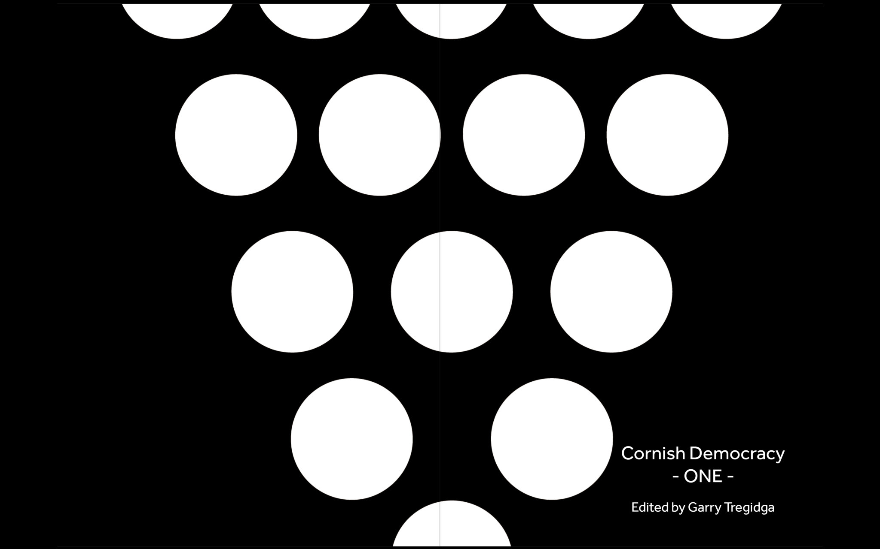
Cover Concept
Cover Concept

Slide 8
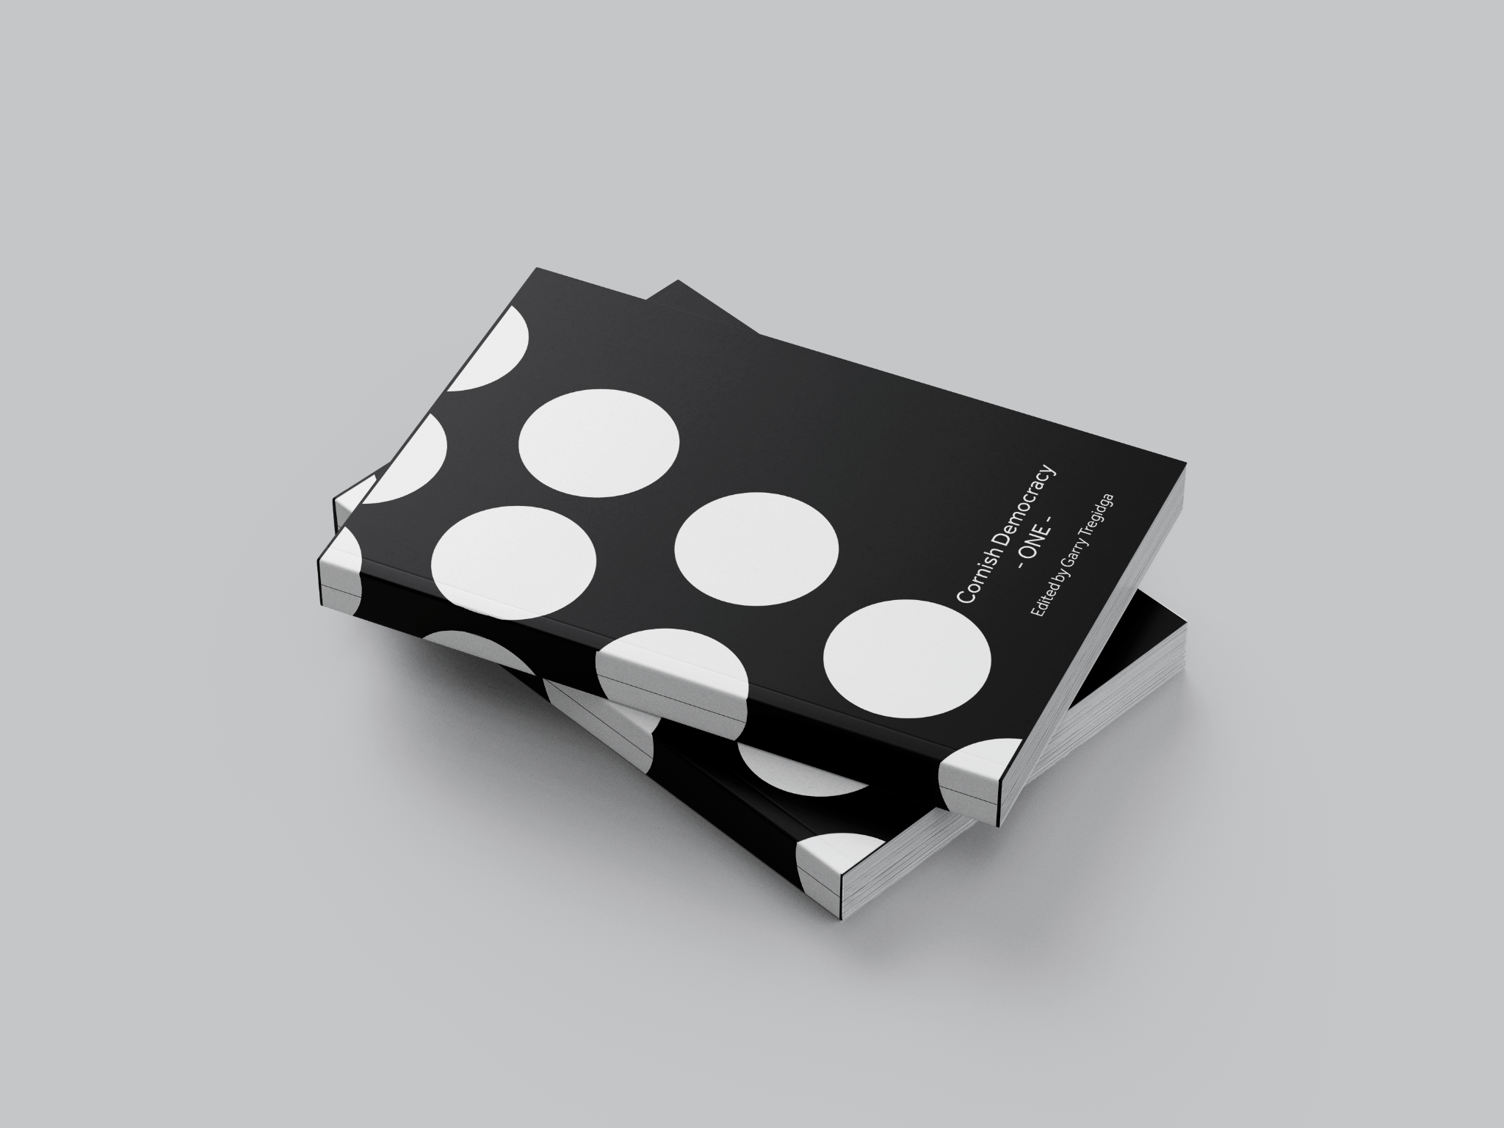
Mockup 1
Mockup 1 – Wrap Around Cover Concept

Slide 9
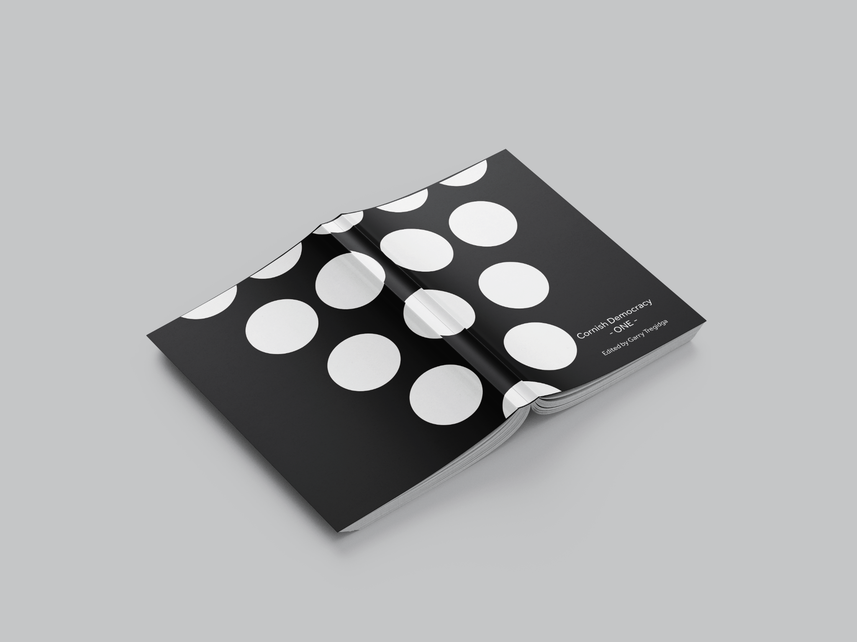
Mockup 2
Mockup 2 – Wrap Around Cover Concept

Slide 10
Outline Specification
A minimal design creates a high visual impact (size, location).
The Bezants may be moved around. Moving the bezants may be used as a design device for subsequent publications.
For each new publication, the colour of the bezants and background are changed.
For each volume of Cornish Democracy, the background stays black and the Bezants change colour.
For each volume of Cornish Studies, the Bezants may be black with the background colours changed.
The next slide shows a few of these ideas.

Slide 11
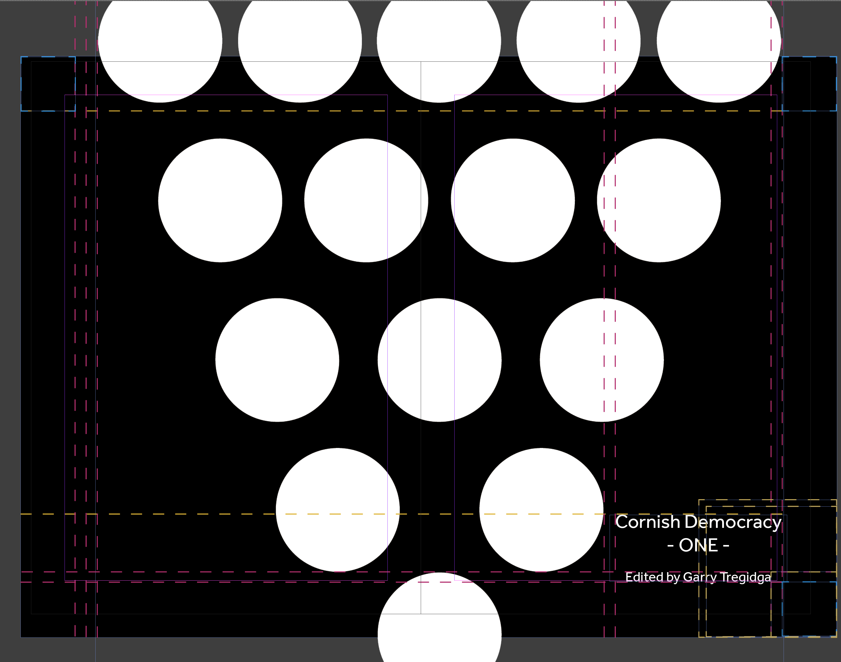
Brand
Specification
&
Guidelines
These next 4 slides show how the cover was created, and how to create it to an exact copy.
The document size I have used is 310mm X 221mm (including the spine width).

Slide 12
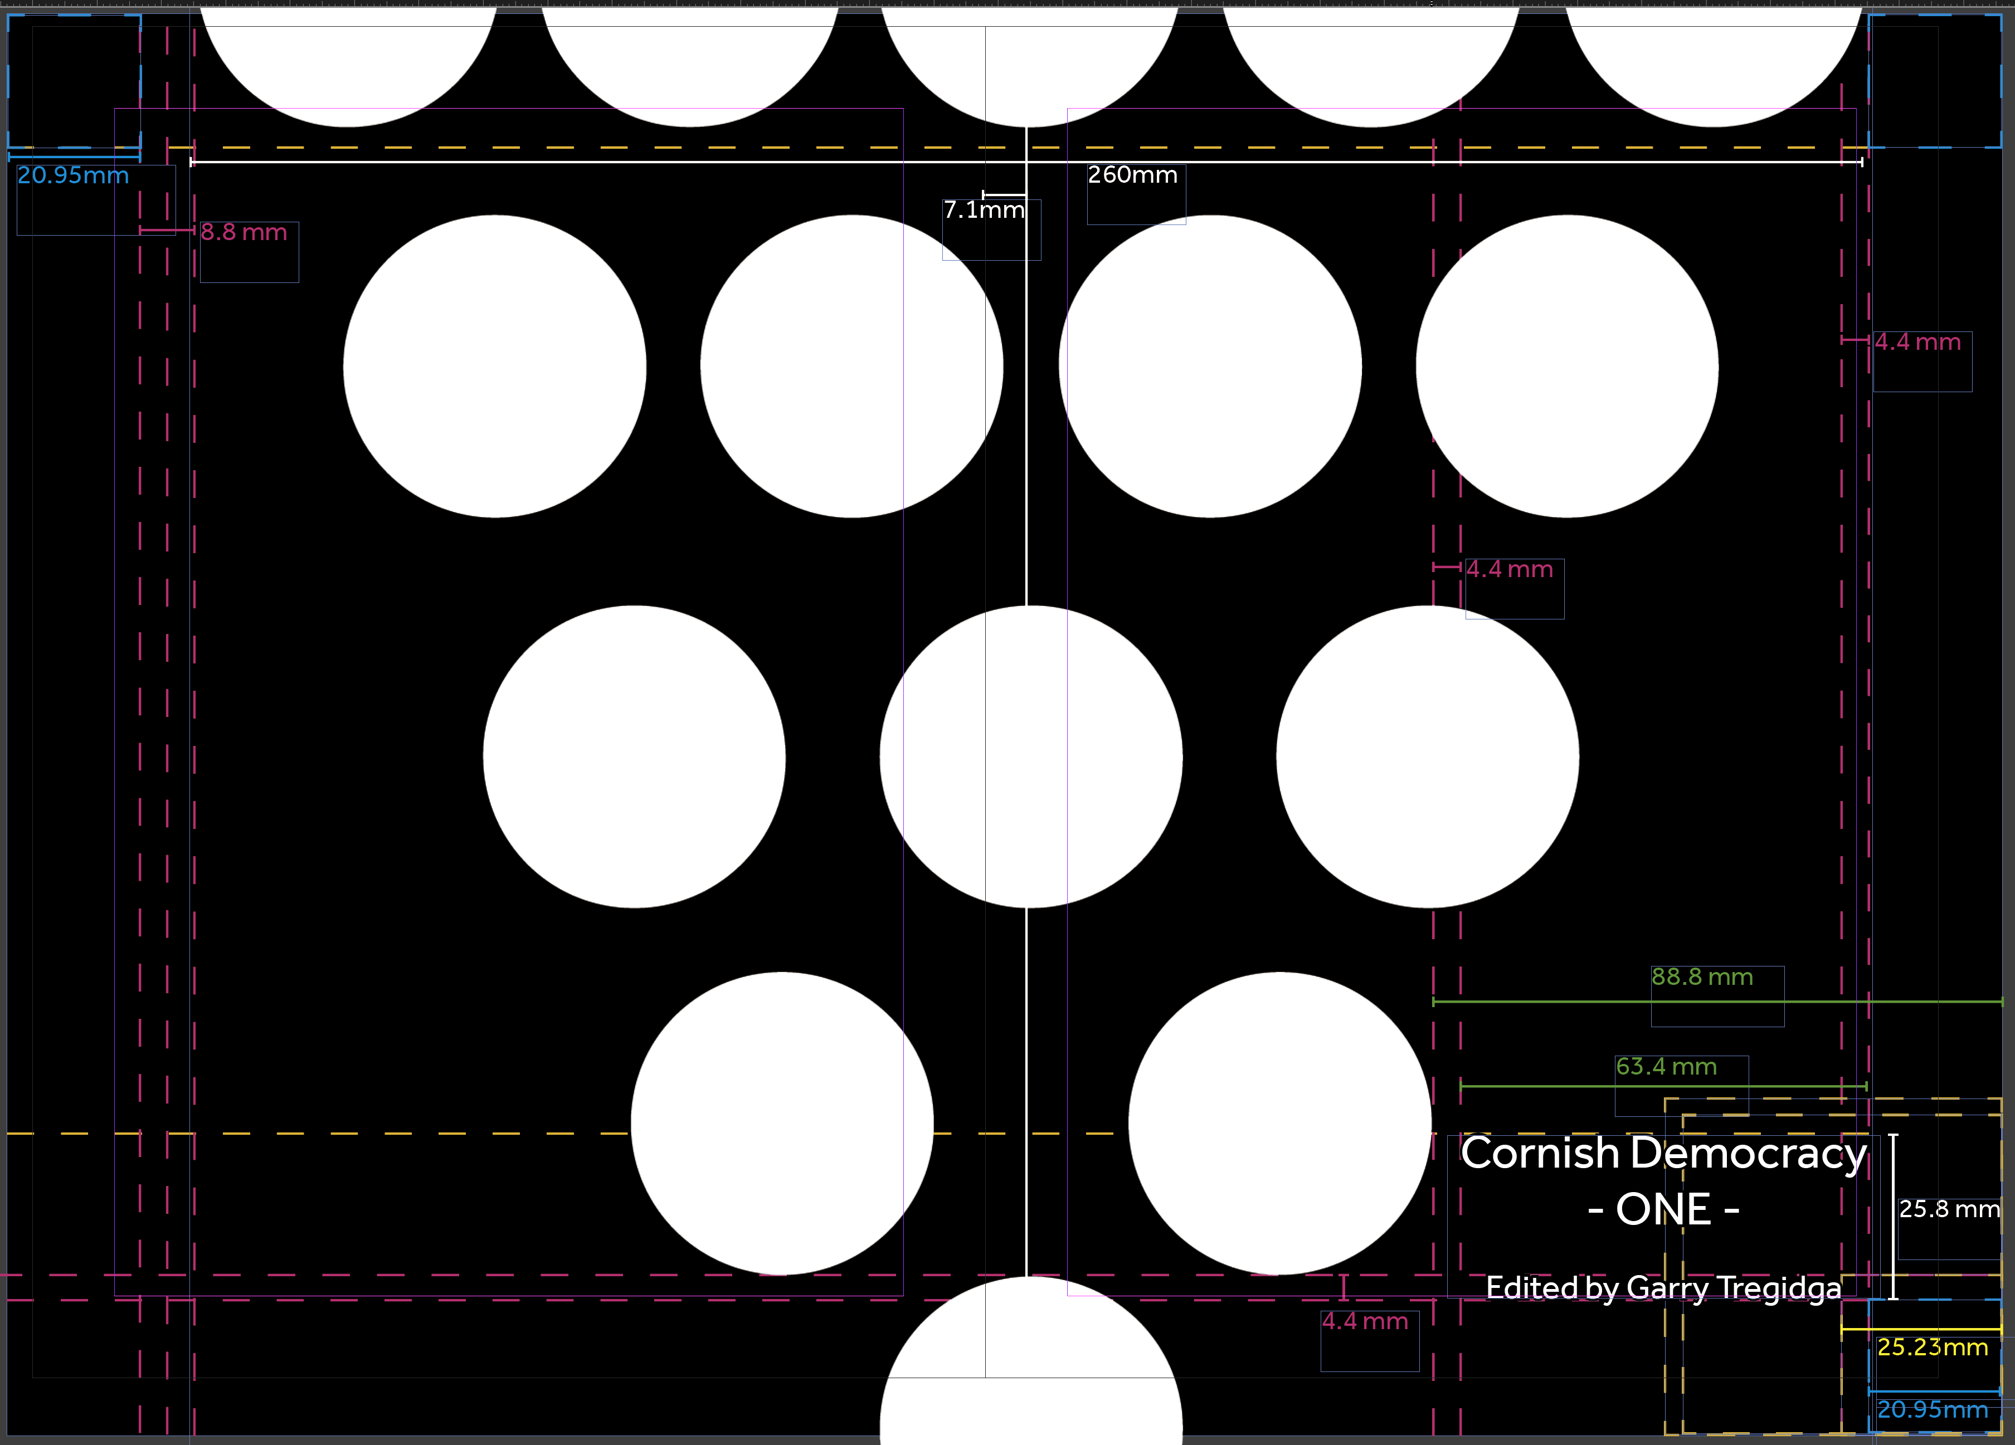

Slide 15
Future Designs
Ideas

Slide 16
Next Steps
If you approve this design, only volume information is needed to proceed to the next step.
I will need to know the number of internal pages and their thickness (paper choice). This allows me to determine the thickness of the spine.
If any changes are needed, please let me know, and I will revise this document.

Slide 17
Thank you.

